Slide 1




Needfinding, POVs, HMWs, Brainstorming, & Experience Prototypes report

Slide 2


WE WILL COVER...
01
05
The team & topic
Solutions
02
06
Additional Needfinding
Prototypes
03
07
POVs
Summary
04
08
HWMs
Next steps

Slide 3
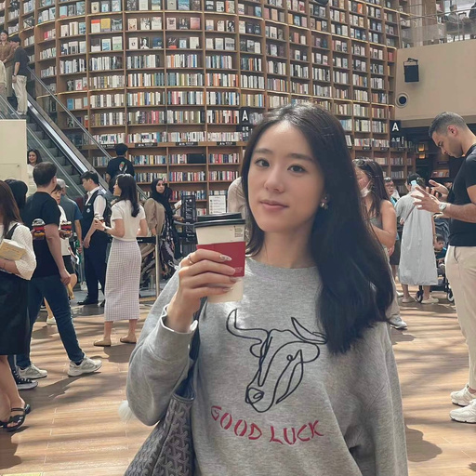
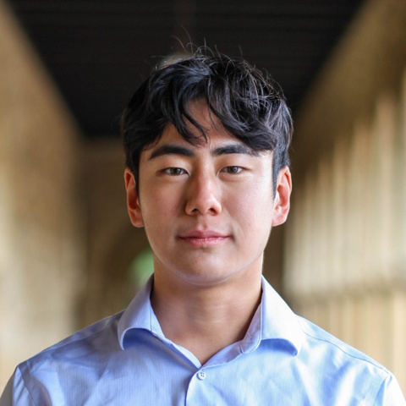
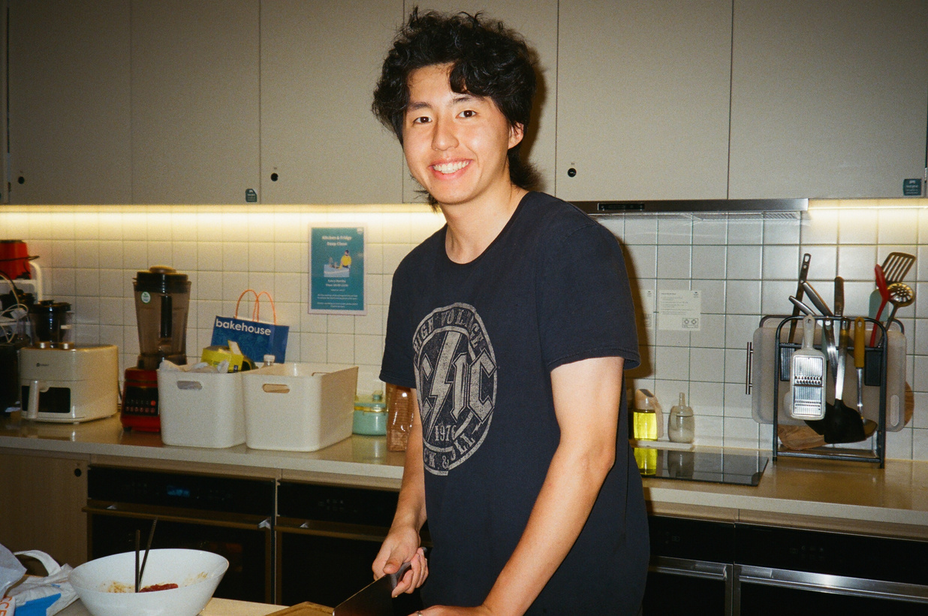
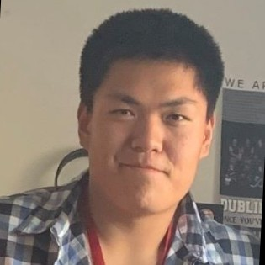
Meet the team!
Sally
Steve
ZIjian
ERIC
Economics ‘25
Hong Kong
CS ‘25
California
Symsys ‘26
Chengdu, China
CS ‘24
California

Slide 4


why this topic
Why education development and the focus on international students?
Personal Experience & Awareness
Relevance & Reach
Interest

Slide 5

Old focus:
U.S. college access for international students
Updated focus:
Bridging the information gap for international students applying to U.S. college
Selecting New Participants:
Two new students, one domestic and one international

Slide 6
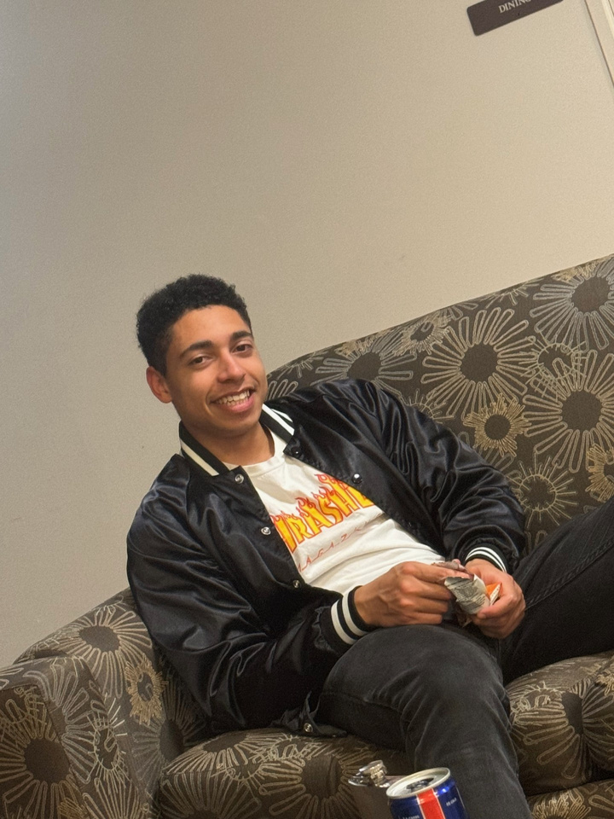
College Graduate
Background
Recently graduated last spring from Stanford
Working at big Technology Company as a hardware designer
Went to HS in an expensive private school in Florida
College Graduate
Florida Private HS
Middle Class
Interview Format: In-person
Key Quotes
“The School’s college application help was generally not useful.”
“I would of had no shot of getting into a good school if I went to Ron DeSantis’ public schools.”

Slide 7
Spent a lot of time at after-school programs and commuting
Felt miserable at HS, almost no time at home.
Made most friends with college-orientated friends
Classmates had a a leg up due to privileged background
Advice from like-minded friends is better than school
Thinks he has other family members depending on him
SAY
THINK
He didn’t really enjoy his ECs
Doing more activities was more likely to be better than excelling at one
Stopped most of his EC after college
Parents spent most of their savings to send him and his brother to private school
School’s help was generally not useful
Like-minded friends have better advice bc of extra resources
Friends and him created clubs and teams for “college applications”
Think that School’s function is employment
School and friends didn’t expect him to get accepted into a top school
Aware of financial situation, chose engineering ECs to help with the situation
Due to his schedule, he felt that he grew distant from his family
Colleges could not fairly judge him if he was in public school
He was unseen in HS due to his academic diligence
School was not great, but public schools were not competitive at all in Florida
Spent a large amount of his energy for ECs
Would come home and collapse into his bed without speaking to anyone
DO
FEEL
Lots of his struggles came from the commute
Unrecognized for his work and efforts by the school
Lived far away from other local students, from a different community
Envied the lifestyle with other friends
this does haha
Didn’t not commute for “fun activities” due to drive time
Participated in any opportunities he thought would boost his chances
Required a few hours of commuting each day to attend school
Felt that his group of friends was generally ostracized
Proud when he surprised his class and school by being a “dark horse” in college apps.
Pressure to excel in academics for financial purposes.
Feels regret of not exploring other options and opportunities
Didn’t spend much time at home due to commute
Missed a lot of high school experiences
Took as many AP classes as allowed
Didn’t spend much time outside of “clubs for college” or school
Jaded due to over-exposure to academic activities
Felt guilty if he were not to make money, due to parents' sizable investment in education
Competitiveness to outachieve his classmates regardless of class difference

Slide 8

needs & insights
They need...
It would be great if...
To have equal access to resources for academic success
Students can get affordable college admission advice

Slide 9
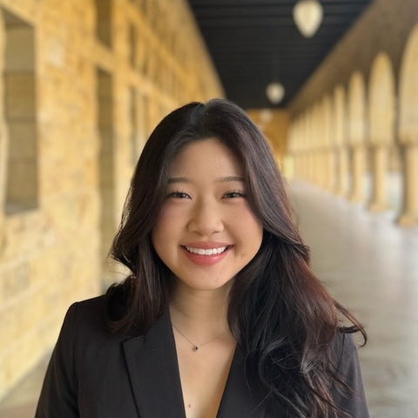
Background
bolivian
student
International college student from Bolivia and Korea
Had a sibling that had been through the application process and a cousin that helped her apply to school
Used multiple paid-services during her application process
Bolivia
Went to International School in Bolivia
Middle Class
Interview Format: In-person
Key Quotes
“It's not necessarily about being super genuine, but about kind of crafting a persona of who you want to be to the colleges.”
“When it comes to [international students], [colleges] want you to understand they want you for our money.”

Slide 10
People were interested in applying to schools in Florida because it was close and had a Latinx community
Her brother did much worse because he didn’t have anyone to help him, unlike her
There should be more students sharing their experience online, through platforms like blogs
The high school system is not well-equipped to support its number of students
The process is flawed since it selects for more domestic students
It’s better to learn from other students who have been through the process
SAY
THINK
She didn’t really care about grades until she noticed other people did
She wants a better way to track college information because she didn’t know what quarter system was like
She wasted a lot of time on activities that he didn’t enjoy just for college applications
The college application process involves a lot of unknown factors
College counselor's involvement was minimal, contributing mainly to logistical tasks like transcripts
There are many resources online that can be consildated
Her profile was more of a persona than something genuine
There should be tools to aggregate the information found online
Didn’t get into NYU, but did get into more competitive schools which she said was because she asked for financial aid
Students who don’t have a good English background are at a disadvantage
There was a lot of parental pressure in her decision-making process.
Counselors are not helpful, especially in international settings
Students don’t really know how to pick schools to apply to, other than word of mouth
Lots of people were super competitive and wanted to get into good schools
Considered pre-med, and she got pressured into applying for CS
COVID gave her the time to focus on college essays
DO
FEEL
Took a lot of AP classes to help with her applications
Annoyed at how expense college application help is so expensive
She didn’t know what to write about in her college essay
Uncertain of if she should talk about her international background in her application
this does haha
Never paid for a service, but wishes she did
Competition was unfair because a lot of people had rich parents who would help with apps
Crammed a lot of applications the days before they were due
Doesn’t respond well to parent pressure, so often did the opposite of what they said
It’s more of a numbers game for international, since she believes colleges don’t want you to apply for fin aid
Tried her best to avoid peer pressure, since it only made her mental health worse off
Interested in cognitive psychology so she changed what she applied as
Started prepping since Junior year of high school
Nervous competing with domestic students
Unsure of how to craft her “persona” to fit what colleges were looking for
Went to a cram school in Korea to study for the SAT
Her cousin helped her out a lot because she had experience consulting other applicants
She didn’t apply to a lot of schools because she felt disadvantaged as an international student
Brother pressured her to be software engineer

Slide 11
needs & insights
They need...
It would be great if...
The college application process to be more affordable and genuine to themselves
Colleges were more transparent about what profiles and stats they’re looking for in applicants

Slide 12
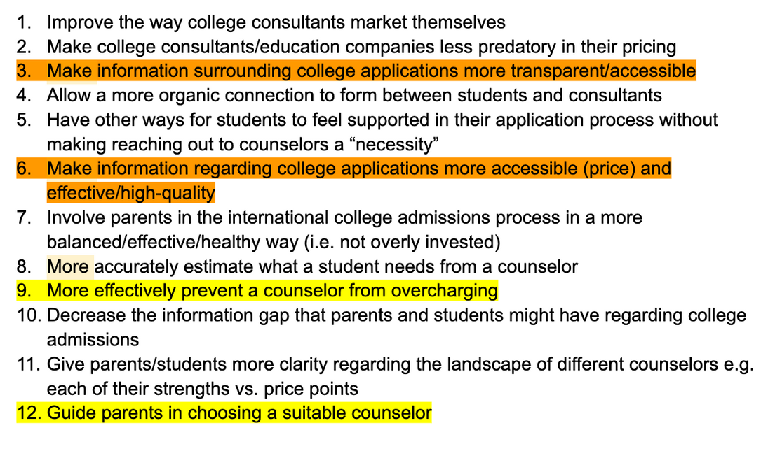
BRainstorm: cHINESE pARENT
POV
HMW
We met... | A mother of a grade-10 student who goes to an international school in Hong Kong. Because her elder child went through the same process a few years before and she plays an active role in her children’s education, she is very familiar with the college consulting landscape.
We were surprised to find out that... | Despite recognizing that the Chinese international college application process has lots of flaws, in particular with the high fees of agencies, she is still keen on looking for a counselor for her younger child because “there is no other way” to succeed in the competitive landscape today.
We wonder if this means... | She wants to seek support for her child through the college application process that has more reasonable fees but still offers non-generic, personalized advice.
It would be game changing to... | Give parents less exploitative college consulting packages while still making sure that the resources are of high quality for their children.

Slide 13
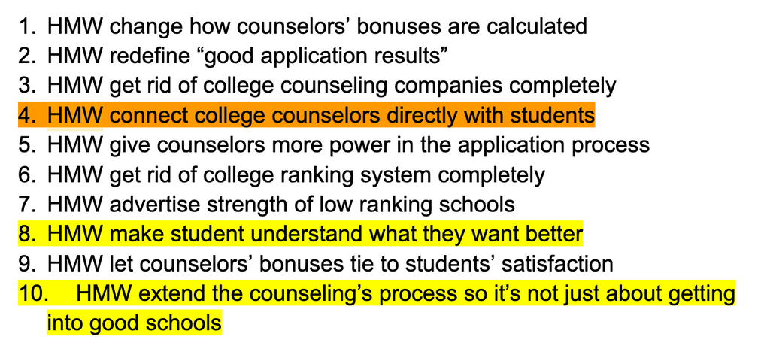
BRainstorm: College counselor
POV
HMW
We met... | Jonas, a college counselor with 8+ years of experience. He has worked in Vietnam and mainland China before, now works for a private college application consulting company in Hong Kong.
We were surprised to find out that... | College consulting companies’ interests are tied to college rankings. In other words, their pay is tied to the rankings of schools their students got into, even if the schools don’t match students’ personalities.
We wonder if this means... | College counselors want to have more autonomy to help students with fewer outside factors.
It would be game changing to... | Have a platform where college counselors can find students directly without private companies.

Slide 14
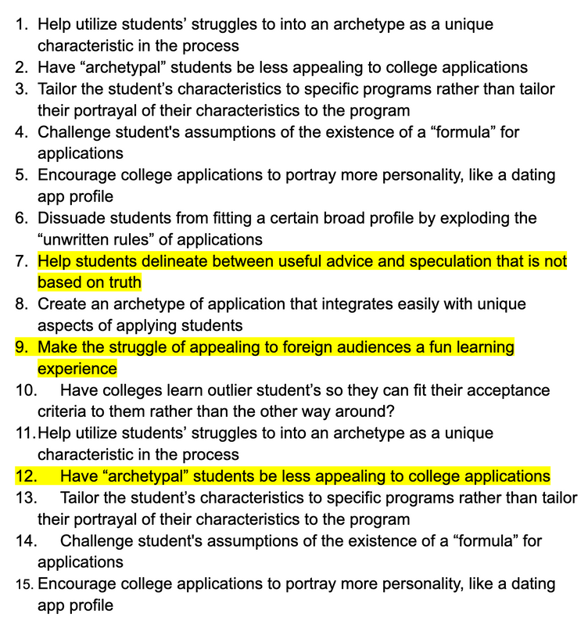
BRainstorm: intl student
POV
HMW
We met... | Karim is a wealthy international student from a French school in London attending Stanford University with two brothers who also attended Stanford.
We were surprised to find out that... | Karim’s main struggle was appealing to what he thought American universities wanted, especially with his limited exposure to formal resources or advice.
We wonder if this means... | Karim created a fabricated portrayal of themself to fit a certain cookie-cutter archetype of a student that he or his brothers believed was more likely to be accepted.
It would be game changing to... | Help students navigate beyond superficial aspects of the college application process, convincing them that they need to convey themselves authentically without omitting their unique strengths and qualifications.

Slide 15
Open line of communication between college admissions to high school students

Slide 16
prototype 1
Critical Assumption | Students care about programs specific to their interest, but are not really knowledgeable about them.
Experience Prototype | Rank factors by how important each one was to their decision in choosing a college & by how easily they found information on it (Post-it notes).
Test Subject(s) | Stanford student. Recruited from a mutual friend. Relevant because they applied to multiple universities.

Slide 17
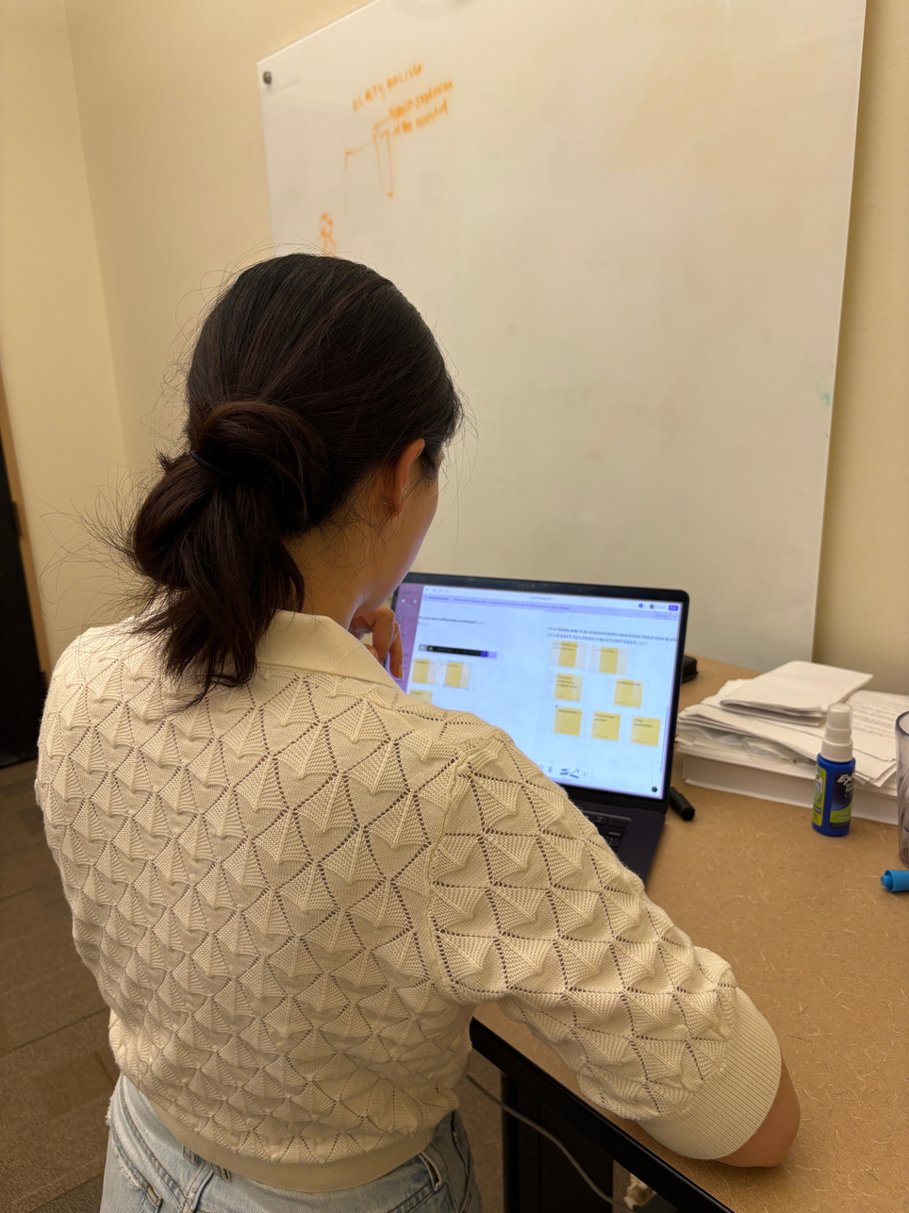
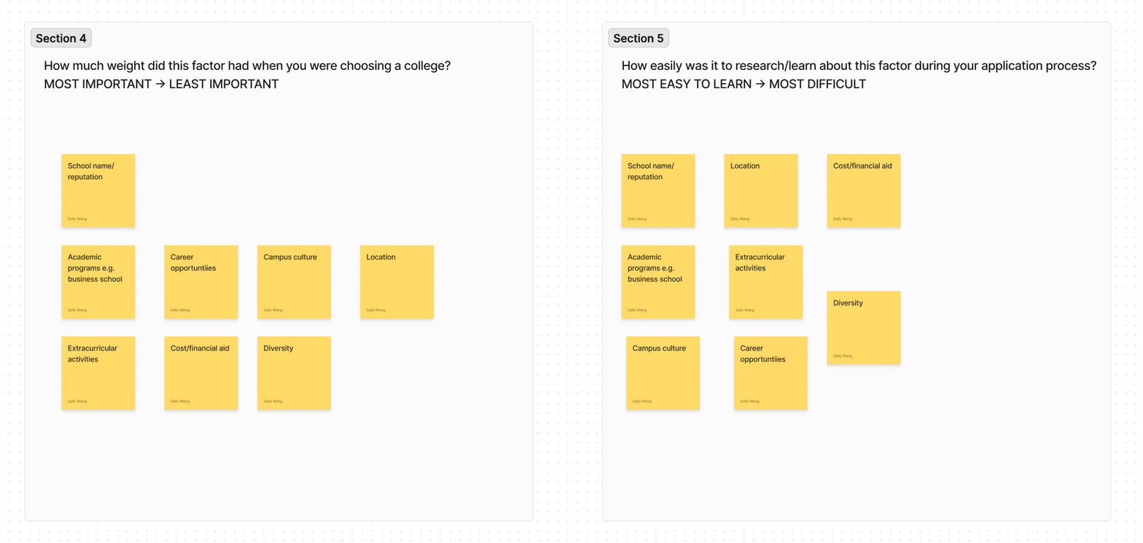

Slide 18

REFLECTION
What worked:
Student expressed they did consider academic programs.
Students were engaged and personally reflected on what they valued.
What didn’t work:
For smaller schools, it was harder to find information on how their programs are different/unique.
Student expressed it was harder to find information about programs at smaller colleges, but they did not consider this to be a big problem.
They ranked it based on what they thought colleges wanted.
Implications:
This direction is NOT the most suitable, seeing a notable number of international students overweigh college brand name.
Information accessibility of smaller schools/programs is not something they are concerned with.
The assumption was NOT applicable.

Slide 19

Ethics
Leaves out students interested in smaller schools.
Heavily considers wealthier, very-ambitious college students.
Limited scope in terms of how much information we could choose to include certain factors in the application process.

Slide 20
“Tinder” matching for college counselors and high school students

Slide 21
prototype 2
Critical Assumption | Students care about college counselors’ personalities, personal interests, and values beyond just their academic qualifications.
Experience Prototype | Wrote 15 college counselor profiles and make students choose who they would work with, analyze the reasons behind their decision.
Test Subject(s) | Stanford students. Recruited from friends. Relevant because they used private counseling.

Slide 22
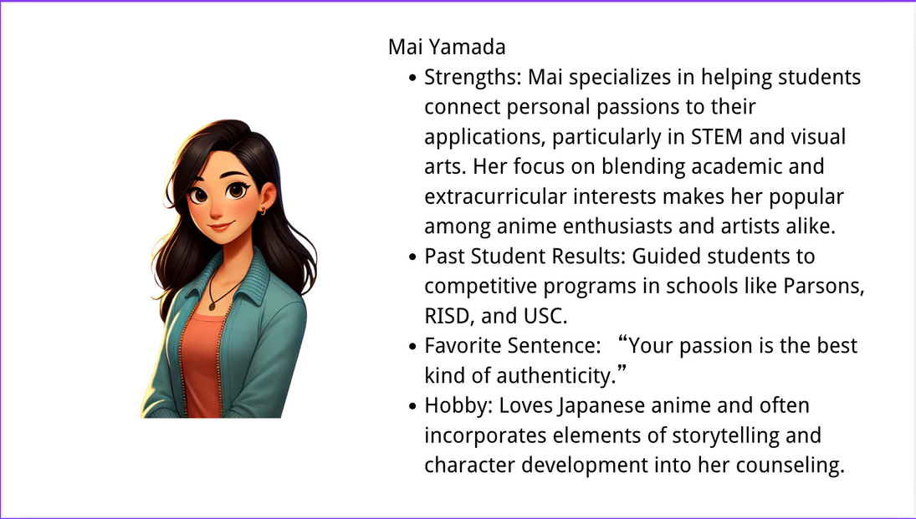
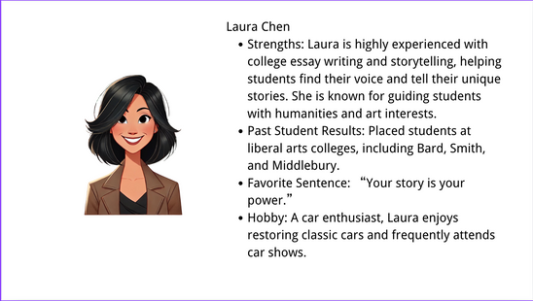
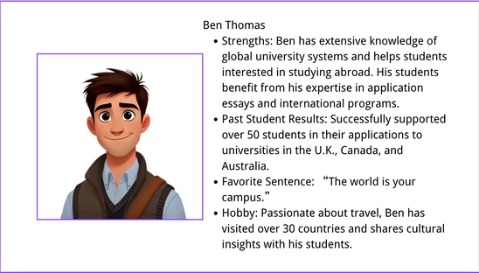
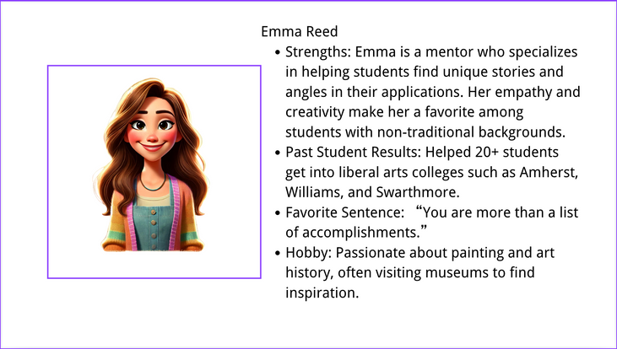
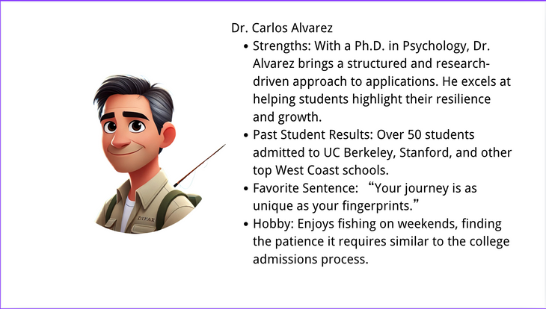
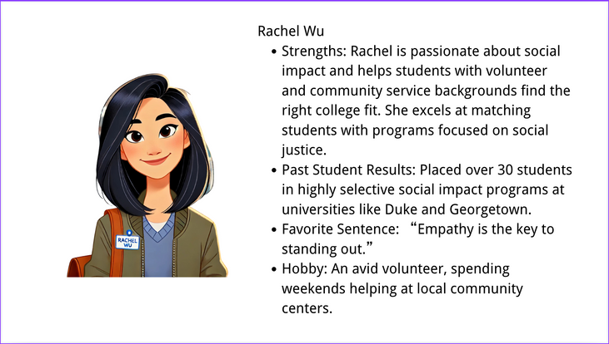
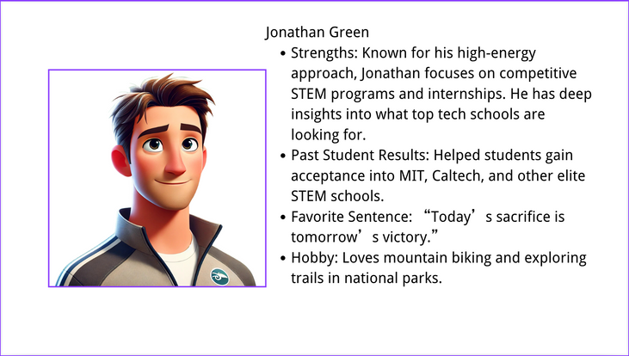
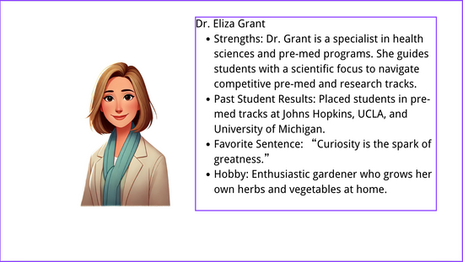
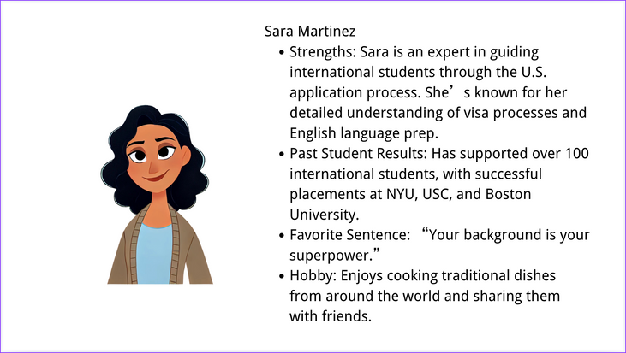
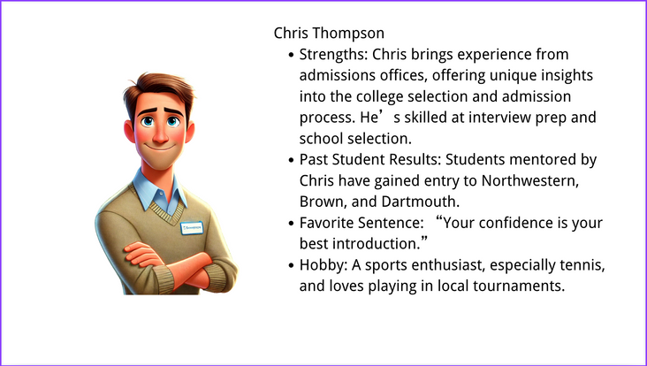
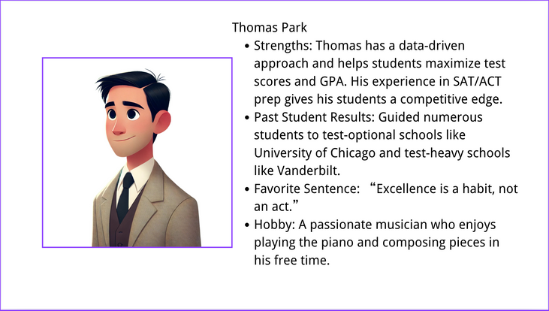
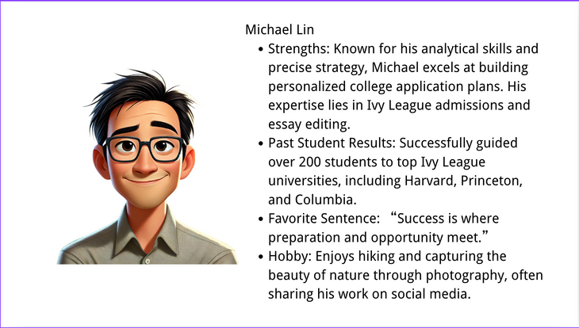
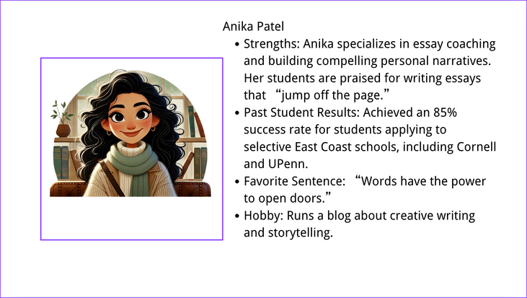
Examples

Slide 23
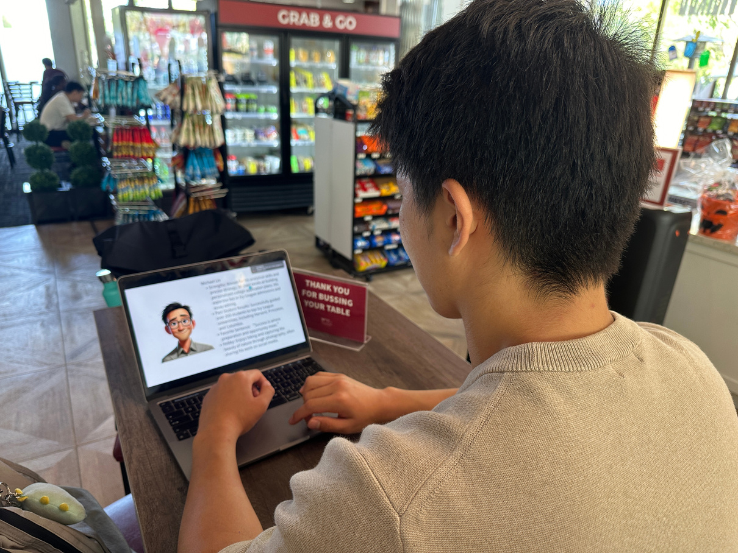
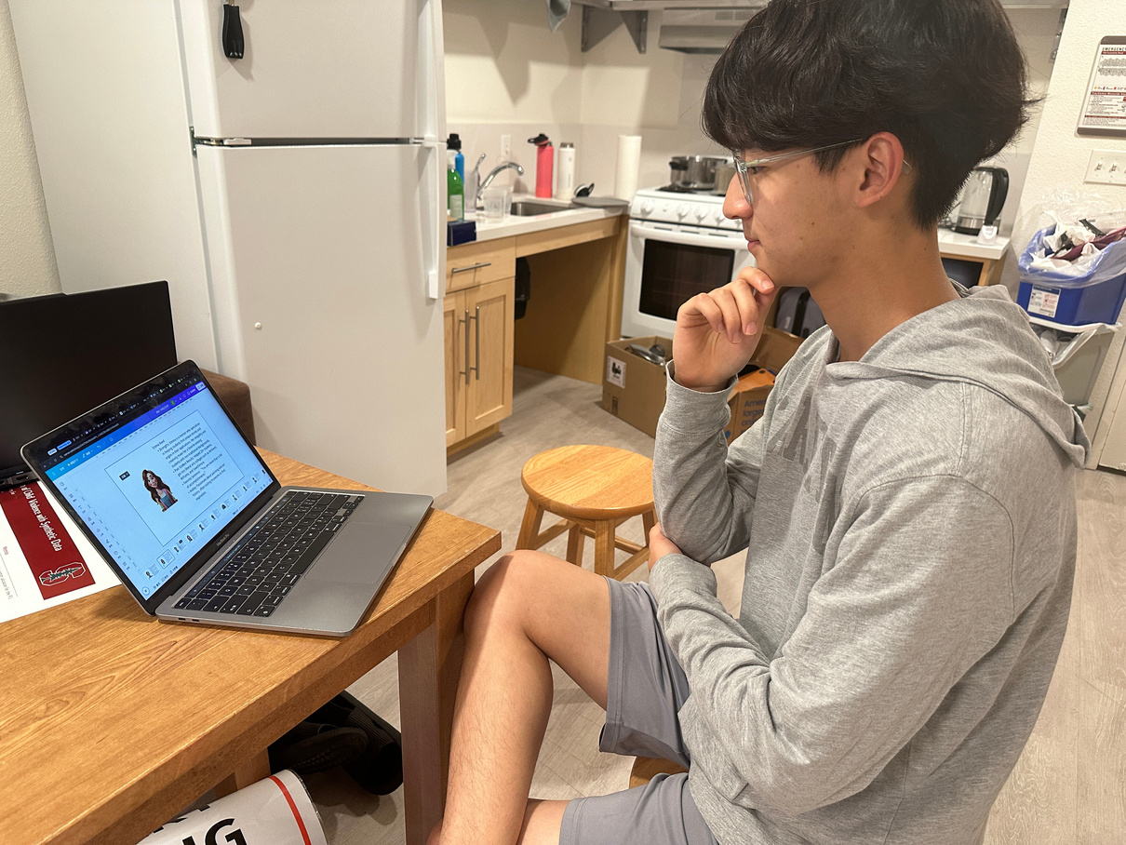
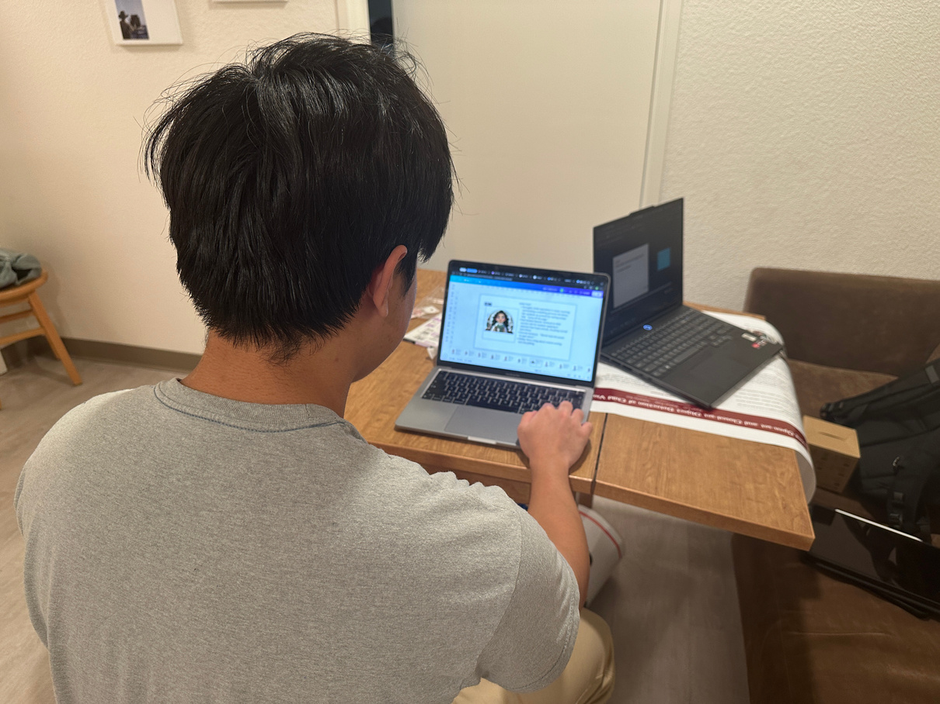
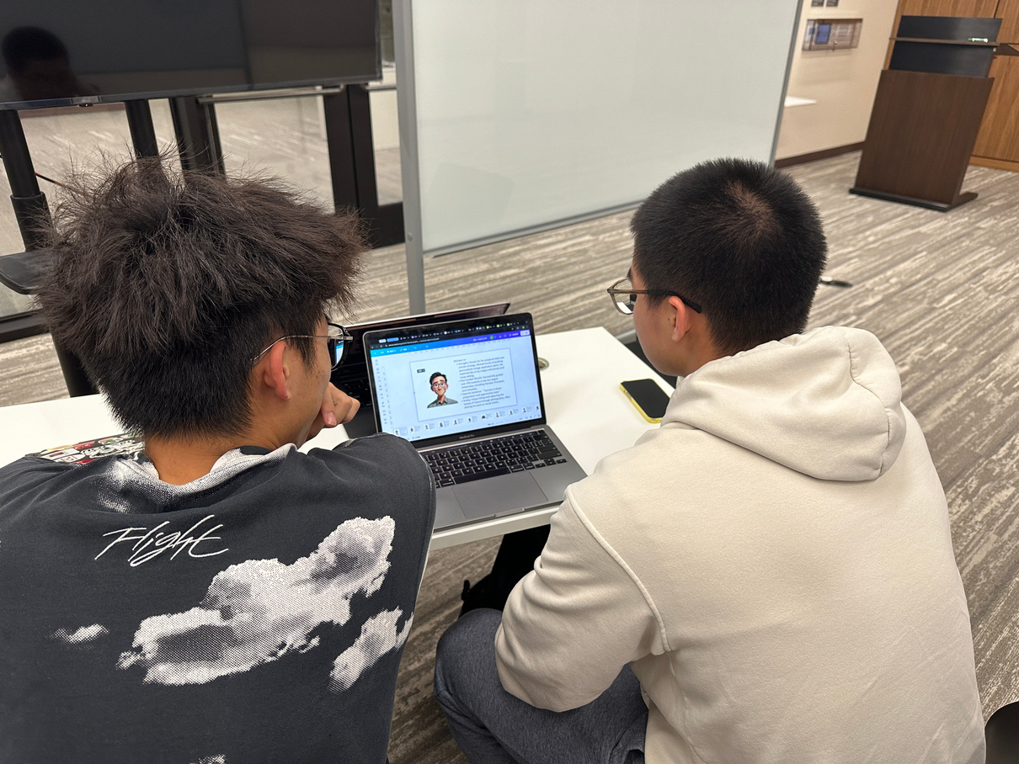
JJ: “This one had good results and he loves nature photography, we share the same passion.”
Nathan: “I like this one because her past students went to schools I am interested in.”
Sokserey: “I would choose her since she is good at revising essays and she likes anime, we would be friends.”
Miguel and Bowen: “He loves traveling and he’s worked with students from different countries, he should be able to help us (international students) .”

Slide 24
REFLECTION
What worked:
Very fun and engaging for participants.
They clearly enjoyed choosing counselors that matched them more closely, and there was usually a clear option for the students to pick.
What didn’t work:
We could’ve created better profiles with broader information and backgrounds that spoke to more students.
Implications:
The solution IS extremely suitable.
Students work better with counselors that match themselves.
The assumption IS applicable: students do value more than just counselors’ academic qualifications and past results.

Slide 25
Ethics
The counselor profiles are AI-generated. The model is biased, so when I requested it to generate 15 diverse profiles, all were Asian or White.
The profiles are limited in their scope. For example, for students with more niche backgrounds, it might be harder for them to find someone suitable.

Slide 26
Connecting students with peers via a marketplace to exchange information/advice

Slide 27
prototype 3
Critical Assumption | College students are willing to share college advice and need non-college advice from others.
Experience Prototype | Created an exchange for homework help: they did an HCI interview for CS homework help.
Test Subject(s) | Stanford student. Recruited from a friend. Relevant because they applied to multiple universities.

Slide 28
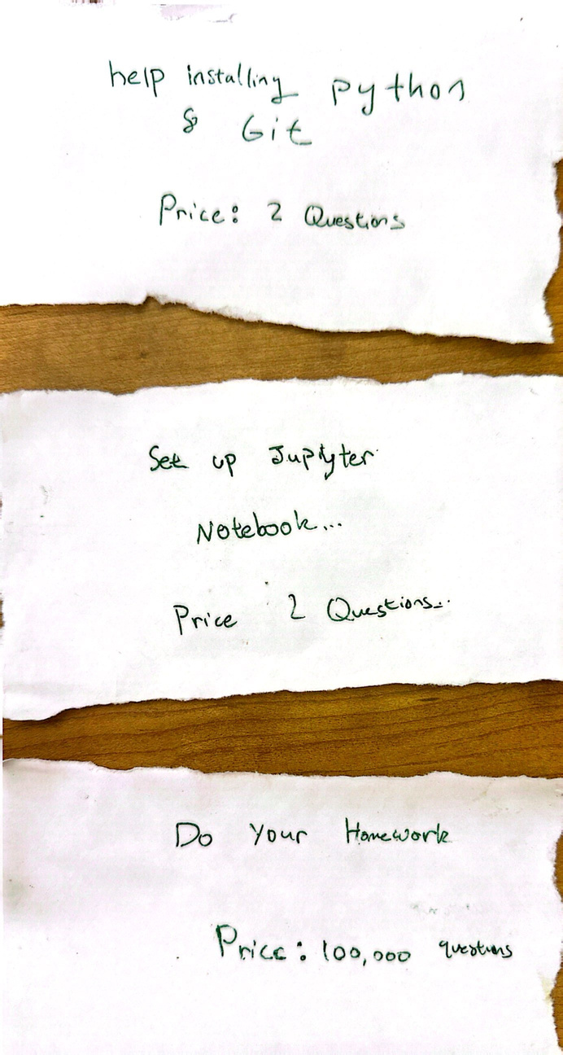
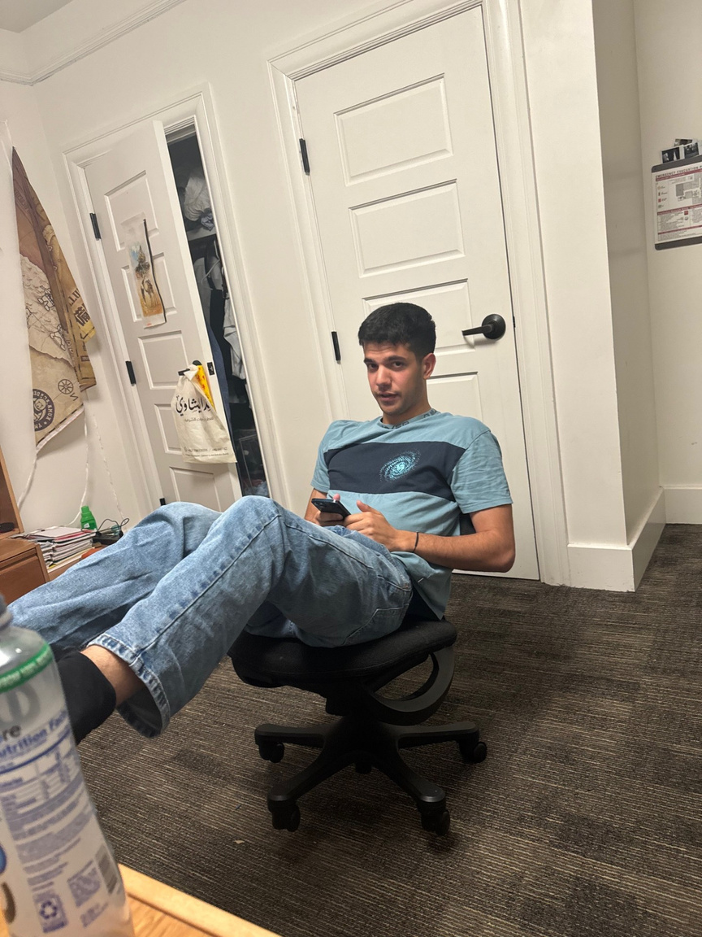

Slide 29
REFLECTION
What worked:
He understood the premise very quickly.
He liked knowing how much commitment he was getting himself into before.
What didn’t work:
Complained about the overhead of getting help requiring multiple back and forth.
Misused the experiment for attempted academic dishonesty (jokingly).
Didn’t like the possibility of only partial help or advice, depending on what I accepted.
Felt transactional.
Implications:
People can easily lie to get information they want.
This solution is NOT the most applicable.
The assumption IS true, but students may find shortcuts like lying.

Slide 30
Ethics
With just an honor system as the basis of this solution, more competitive students will likely have more information to share.
This solution seems to exclude people from more disadvantaged backgrounds, as they may have less information to share.
By opening up the type of information that can be exchanged, we can include broader perspectives and more people.

Slide 31

whats’ next?
Solution 2: “Dating app” matching system
Address aforementioned implications and ethical concerns.
Expand profile information and broaden our scope.
Hone-in on understanding why students desire to work with counselors that match their personalities.

Slide 32
Thank you for listening

Slide 33
APPENDIX

Slide 34
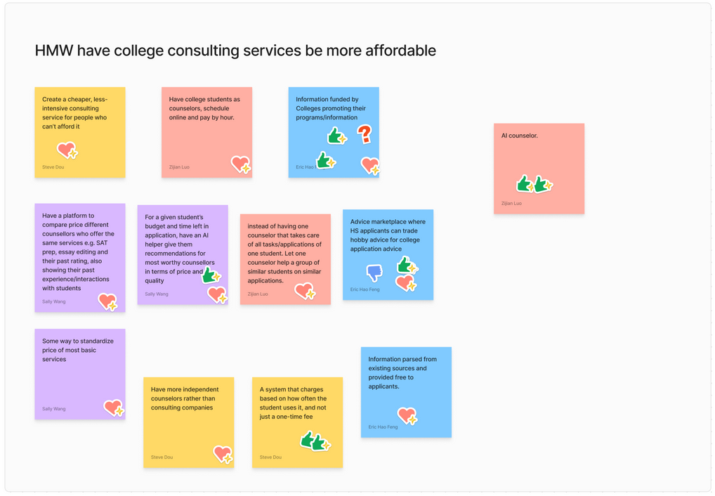
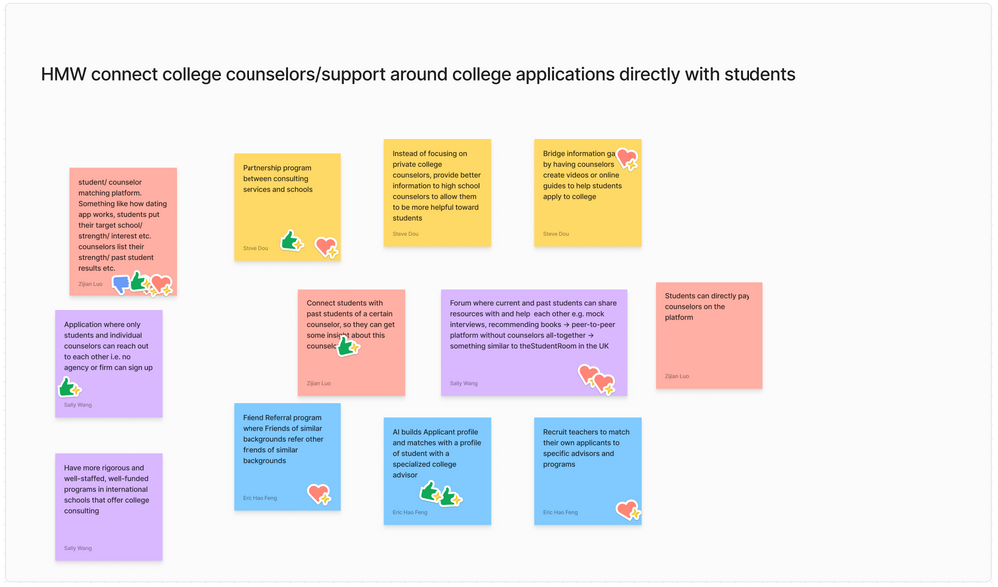
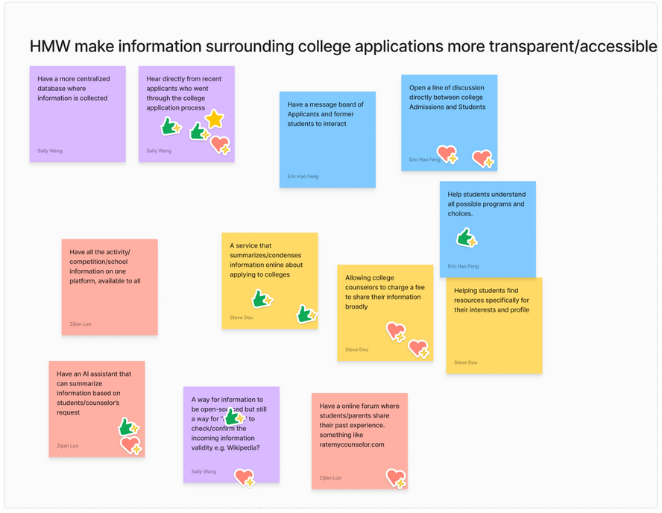
Solution Brainstorm

